Slide 1

15CSE301 Computer Organization and Architecture
Lecture 3
MIPS
Reference:
Chapter 2 – 2.1 -2.6, 2.9
Computer Organization and Design, The hardware / software interface, 3rd Edition
Dr Ganesh Neelakanta Iyer
Associate Professor, Dept of Computer Science and Engg
Amrita Vishwa Vidyapeetham, Coimbatore

Slide 2

Problems in MIPS

Slide 3
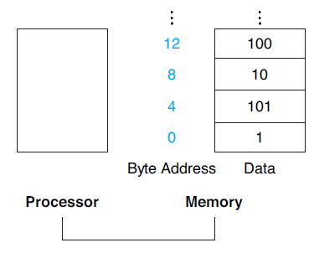
Memory Operands
Arithmetic operations occur only on registers in MIPS instructions
Thus, MIPS has data transfer instructions - that transfer data between memory and registers
To access a word in memory, the instruction must supply the memory address
Memory is just a large, single-dimensional array, with the address acting as the index to that array, starting at 0
For example, in Figure, the address of the third data element is 2, and the value of Memory[2] is 10

Slide 4
Memory Operands
The data transfer instruction that copies data from memory to a register is traditionally called load
The format of the load instruction is the name of the operation followed by the register to be loaded, then a constant and register used to access memory
The sum of the constant portion of the instruction and the contents of the second register forms the memory address.
The actual MIPS name for this instruction is lw, standing for load word

Slide 5
Compiling an Assignment When an Operand Is in Memory
Let’s assume that A is an array of 100 words and that the compiler has associated the variables g and h with the registers $s1 and $s2
Let’s also assume that the starting address, or base address, of the array is in $s3.
Compile this C assignment statement:
g = h + A[8];
QUESTION: How many instructions are required in MIPS to achieve this?

Slide 6
Compiling an Assignment When an Operand Is in Memory
Although there is a single operation in this assignment statement, one of the operands is in memory, so we must first transfer A[8] to a register
The address of this array element is the sum of the base of the array A, found in register $s3, plus the number to select element 8
The data should be placed in a temporary register for use in the next instruction
QUESTION: What is the first compiled instruction?

Slide 7
Compiling an Assignment When an Operand Is in Memory
lw $t0,32($s3) # Temporary reg $t0 gets A[8]
In MIPS, words must start at addresses that are multiples of 4
This requirement is called an alignment restriction, and many architectures have it
Byte addressing also affects the array index
To get the proper byte address in the code above, the offset to be added to the base register $s3 must be 4 × 8, or 32, so that the load address will select A[8] and not A[8/4]
QUESTION: What is the next instruction?

Slide 8
Compiling an Assignment When an Operand Is in Memory
The following instruction can operate on the value in $t0 (which equals A[8]) since it is in a register
The instruction must add h (contained in $s2) to A[8] ($t0) and put the sum in the register corresponding to g (associated with $s1):
add $s1,$s2,$t0 # g = h + A[8]
The constant in a data transfer instruction (8) is called the offset, and the register added to form the address ($s3) is called the base register

Slide 9
A note about store
The instruction complementary to load is traditionally called store
It copies data from a register to memory
The format of a store is similar to that of a load:
the name of the operation,
followed by the register to be stored,
then offset to select the array element, and
finally the base register
Once again, the MIPS address is specified in part by a constant and in part by the contents of a register
The actual MIPS name is sw, standing for store word

Slide 10
Compiling Using Load and Store
Assume variable h is associated with register $s2 and the base address of the array A is in $s3
QUESTION 1: How many MIPS instructions are required for the C statement below?
QUESTION 2: What is the MIPS assembly code for the same?
A[12] = h + A[8];

Slide 11
Answer
Although there is a single operation in the C statement, now two of the operands are in memory, so we need even more MIPS instructions
The first two instructions are the same as the prior example, except this time we use the proper offset for byte addressing in the load word instruction to select A[8], and the add instruction places the sum in $t0:
lw $t0,32($s3) # Temporary reg $t0 gets A[8]
add $t0,$s2,$t0 # Temporary reg $t0 gets h + A[8]

Slide 12
Answer
sw $t0,48($s3) # Stores h + A[8] back into A[12]
Load word and store word are the instructions that copy words between
memory and registers in the MIPS architecture

Slide 13
Question
QUESTION: IS the below statement correct? Reason your answer
add $s1, $s2, 16($s3)

Slide 14
Answer
No
An operand from memory can not be specified in an MIPS arithmetic/logic instruction

Slide 15
Translating a MIPS Assembly Instruction into a Machine Instruction
Represent the following instruction in decimal and binary
add $t0,$s1,$s2
Remember all R-type instructions use a 000000 opcode. The operation is specified by the function field
Refer the MIPS Instruction sheet to find out the right function value

Slide 16
Answer
add $t0,$s1,$s2
The first and last fields (containing 0 and 32 in this case) in combination tell the MIPS computer that this instruction performs addition
Always write field width and names in the instruction formats
6 bits
5 bits
5 bits
5 bits
5 bits
6 bits
31
op
rs
rt
rd
shamt
funct
0
0
17
18
8
0
32
Decimal
000000
10001
10010
01000
00000
100000
Binary

Slide 17
Another one
Represent following instruction in binary and decimal lw $9, 1200($8) == lw $t1, 1200($t0)
6 bits
5 bits
5 bits
16 bits
31
0
op
rs
rt
offset
35
8
9
1200
Decimal
100011
01000
01001
0000010010110000
Binary

Slide 18
Translate the following into Machine Language
If $t1 has the base of the array A and $s2 corresponds to h, the assignment statement
A[300] = h + A[300];
STEP QUESTION 1: Write MIPS equivalent
STEP QUESTION 2: Write Machine Language equivalent

Slide 19
Answer for first step Assembly equivalent
lw $t0,1200($t1) # Temporary reg $t0 gets A[300]
add $t0,$s2,$t0 # Temporary reg $t0 gets h + A[300]
sw $t0,1200($t1) # Stores h + A[300] back into A[300]
STEP QUESTION 2: Write Machine Language equivalent

Slide 20
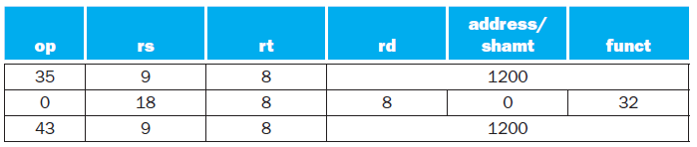
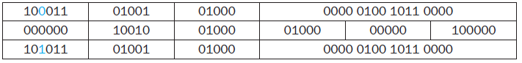
Answer to Second step Machine Equivalent

Slide 21
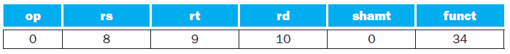
Question
What MIPS instruction does this represent?
1. sub $t0, $t1, $t2
2. add $t2, $t0, $t1
3. sub $t2, $t1, $t0
4. sub $t2, $t0, $t1

Slide 22
Answer
Option 4

Slide 23
Write Machine equivalent
sll $t2,$s0,4 # reg $t2 = reg $s0 << 4 bits

Slide 24
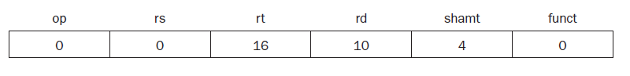
Answer
The encoding of sll is 0 in both the op and funct fields, rd contains 10 (register $t2), rt contains 16 (register $s0), and shamt contains 4 The rs field is unused and thus is set to 0
Shift left logical provides a bonus benefit
Shifting left by i bits gives the same result as multiplying by 2^{i}, just as shifting a decimal number by i digits is equivalent to multiplying by 10^{i}
For example, the above sll shifts by 4, which gives the same result as multiplying by 2⁴ or 16

Slide 25
Question
if register $t2 contains
0000 0000 0000 0000 0000 1101 1100 0000_{two}
and register $t1 contains
0000 0000 0000 0000 0011 1100 0000 0000_{two}
then, after executing the MIPS instruction
and $t0,$t1,$t2 # reg $t0 = reg $t1 & reg $t2
What will be the value of register $t0?

Slide 26
Answer
0000 0000 0000 0000 0000 1100 0000 0000_{two}

Slide 27
Question
In the following code segment, f, g, h, i, and j are variables. If the five variables f through j correspond to the five registers $s0 through $s4, what is the compiled MIPS code for this C if statement?
if (i == j)
f = g + h;
else
f = g – h;

Slide 28
QUIZ – MIPS on Tuesday 25th June

Slide 29
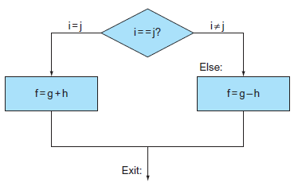
Flow chart
The left box corresponds to the then part of the if statement, and the right box corresponds to the else part.

Slide 30
Answer
The first expression compares for equality, so it would seem that we would want the branch if registers are equal instruction (beq)
In general, the code will be more efficient if we test for the opposite condition to branch over the code that performs the subsequent then part of the if (the label Else is defined below) and so we use the branch if registers are not equal instruction (bne):

Slide 31
Answer
bne $s3,$s4,Else # go to Else if i ≠ j
The next assignment statement performs a single operation, and if all the operands are allocated to registers, it is just one instruction:
add $s0,$s1,$s2 # f = g + h (skipped if i ≠ j)
We now need to go to the end of the if statement
This example introduces another kind of branch, oft en called an unconditional branch. This instruction says that the processor always follows the branch
To distinguish between conditional and unconditional branches, the MIPS name for this type of instruction is jump, abbreviated as j (the label Exit is defined below).
j Exit # go to Exit

Slide 32
Answer
The assignment statement in the else portion of the if statement can again be compiled into a single instruction
We just need to append the label Else to this instruction
We also show the label Exit that is after this instruction, showing the end of the if-then-else compiled code:
Else:sub $s0,$s1,$s2 # f = g – h (skipped if i = j)
Exit:

Slide 33
Final answer
bne $s3,$s4,Else # go to Else if i ≠ j
add $s0,$s1,$s2 # f = g + h (skipped if i ≠ j)
j Exit # go to Exit
Else: sub $s0,$s1,$s2 # f = g – h (skipped if i = j)
Exit:

Slide 34
While loop
while (save[i] == k)
i += 1;
Assume that i and k correspond to registers $s3 and $s5 and the base of the array save is in $s6. What is the MIPS assembly code corresponding to this C segment?

Slide 35
Answer
The first step is to load save[i] into a temporary register
Before we can load save[i] into a temporary register, we need to have its address
Before we can add i to the base of array save to form the address, we must multiply the index i by 4 due to the byte addressing problem
Fortunately, we can use shift left logical, since shifting left by 2 bits multiplies by 2² or 4

Slide 36
Answer
We need to add the label Loop to it so that we can branch back to that instruction at the end of the loop:
Loop: sll $t1,$s3,2 # Temp reg $t1 = i * 4
To get the address of save[i], we need to add $t1 and the base of save in $s6:
add $t1,$t1,$s6 # $t1 = address of save[i]
Now we can use that address to load save[i] into a temporary register:
lw $t0,0($t1) # Temp reg $t0 = save[i]

Slide 37
Answer
The next instruction performs the loop test, exiting if save[i] ≠ k:
bne $t0,$s5, Exit # go to Exit if save[i] ≠ k
The next instruction adds 1 to i:
addi $s3,$s3,1 # i = i + 1
The end of the loop branches back to the while test at the top of the loop
We just add the Exit label after it, and we’re done:
j Loop # go to Loop
Exit:

Slide 38
Final Code
Loop: sll $t1,$s3,2 # Temp reg $t1 = i * 4
add $t1,$t1,$s6 # $t1 = address of save[i]
lw $t0,0($t1) # Temp reg $t0 = save[i]
bne $t0,$s5, Exit # go to Exit if save[i] ≠ k
addi $s3,$s3,1 # i = i + 1
j Loop # go to Loop
Exit:
If we assume we place the loop starting at location 80000 in memory, what is the MIPS machine code for this loop?

Slide 39
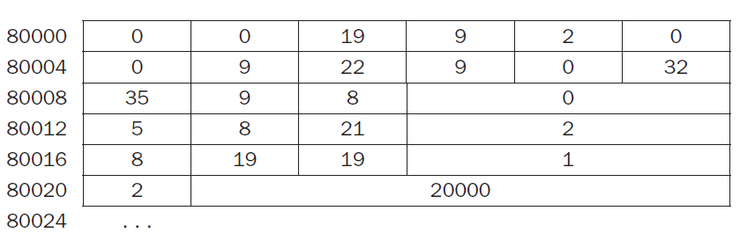
Answer

Slide 40
Decoding machine language
What is the assembly language statement corresponding to this machine instruction?
00af8020hex

Slide 41
Answer
The first step in converting hexadecimal to binary is to find the op fields: (00af8020hex)
Bits:
We look at the op field to determine the operation
When bits 31-26 are 000000, it is an R-format instruction
Let’s reformat the binary instruction into R-format fields
Which instruction is it? (Hint: Look at funct bits)
31 | 30 | 29 | 28 | 27 | 26 | 25 | 24 | 23 | 22 | 21 | 20 | 19 | 18 | 17 | 16 | 15 | 14 | 13 | 12 | 11 | 10 | 9 | 8 | 7 | 6 | 5 | 4 | 3 | 2 | 1 | 0
0 | 0 | 0 | 0 | 0 | 0 | 0 | 0 | 1 | 0 | 1 | 0 | 1 | 1 | 1 | 1 | 1 | 0 | 0 | 0 | 0 | 0 | 0 | 0 | 0 | 0 | 1 | 0 | 0 | 0 | 0 | 0
op |  |  |  |  |  | rs |  |  |  |  | rt |  |  |  |  | rd |  |  |  |  | shamt |  |  |  |  | funct
0 | 0 | 0 | 0 | 0 | 0 | 0 | 0 | 1 | 0 | 1 | 0 | 1 | 1 | 1 | 1 | 1 | 0 | 0 | 0 | 0 | 0 | 0 | 0 | 0 | 0 | 1 | 0 | 0 | 0 | 0 | 0

Slide 42
Answer
In this case, bits 5–0 are 100000, which means this binary pattern represents an add instruction
We decode the rest of the instruction by looking at the field values
The decimal values are 5 for the rs field, 15 for rt, and 16 for rd (shamt is unused)
These numbers represent registers $a1, $t7, and $s0
Now we can reveal the assembly instruction:
add $s0,$a1,$t7

Slide 43
Question: Decode the following Machine code to MIPS equivalent
00001025_{hex}
0005402A_{hex}
11000003_{hex}
00441020_{hex}
20A5FFFF_{hex}
08100001_{hex}
Let the ﬁrst instruction be at address 0x00400000_{hex}

Slide 44
The six machine language instructions in binary:
00000000000000000001000000100101
00000000000001010100000000101010
00010001000000000000000000000011
00000000010001000001000000100000
00100000101001011111111111111111
00001000000100000000000000000001

Slide 45
Select the opcode (ﬁrst 6 bits) to determine the format
00000000000000000001000000100101
00000000000001010100000000101010
00010001000000000000000000000011
00000000010001000001000000100000
00100000101001011111111111111111
00001000000100000000000000000001
Look at opcode: 0 means R-Format, 2 or 3 mean J-Format, otherwise I-Format

Slide 46
Fields separated based on format/opcode
0 | 0 | 0 | 2 | 0 | 37
0 | 0 | 5 | 8 | 0 | 42
4 | 8 | 0 | +3
0 | 2 | 4 | 2 | 0 | 32
8 | 5 | 5 | -1
2 | 1,048,577

Slide 47
MIPS Assembly (Part 1)
Assembly instructions:
0x00400000 or $2,$0,$0
0x00400004 slt $8,$0,$5
0x00400008 beq $8,$0,3
0x0040000c add $2,$2,$4
0x00400010 addi $5,$5,-1
0x00400014 j 0x100001

Slide 48
MIPS Assembly (Part 2)
or $v0,$0,$0
Loop: slt $t0,$0,$a1
beq $t0,$0,Exit
add $v0,$v0,$a0
addi $a1,$a1,-1
j Loop
Exit:

Slide 49
C code equivalent (Must be creative!!!) This is only for your reference
$v0: var1
$a0: var2
$a1: var3
var1 = 0;
while (var3 > 0)
{
var1 += var2;
var3 -= 1;
}

Slide 50

MIPS - Summary

Slide 51
Summary - MIPS Instruction Set
simple instructions all 32 bits wide
very structured, no unnecessary baggage
only three instruction formats
6 bits
5 bits
5 bits
5 bits
5 bits
6 bits
op
rs
rt
rd
shamt
funct
R-Format
6 bits
5 bits
5 bits
16 bits
op
rs
rt
offset
I-Format
6 bits
26 bits
J-Format
op
address

Slide 52
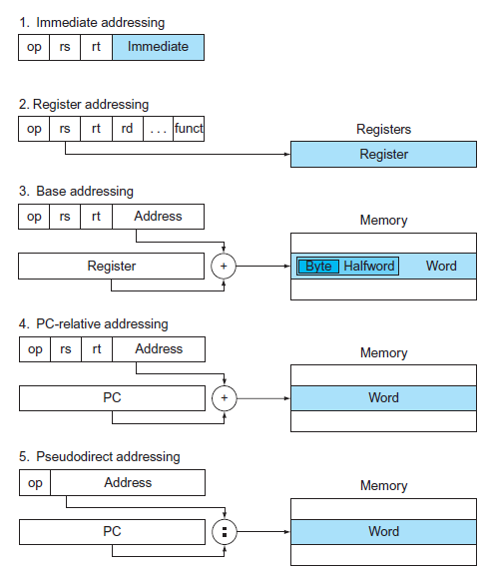
MIPS addressing modes
Immediate addressing
Register addressing
Base or displacement addressing
PC-relative addressing
Pseudodirect addressing,
where the operand is a constant within the instruction itself
where the operand is a register
where the operand is at the memory location whose address is the sum of a register and a constant in the instruction
where the branch address is the sum of the PC and a constant in the instruction
where the jump address is the 26 bits of the instruction concatenated with the upper bits of the PC

Slide 53
MIPS design principles in a nut shell
Simplicity favors regularity
Fixed size instructions, 3 register operands in every arithmetic operation, keeping the register fields at the same place in every instruction format
Smaller is faster
MIPS has 32 32-bit registers,$v0,...$v31, a very large number would increase the clock cycle time.
Good design demands compromise.
The compromise represented by the MIPS design, was to make all the instructions the same length, thereby requiring different instruction formats.
Make the common case fast.
The MIPS instruction set addresses this principal by making constants part of arithmetic instructions. Furthermore, by loading small constants into the upper 16-bits of a register.

Slide 54
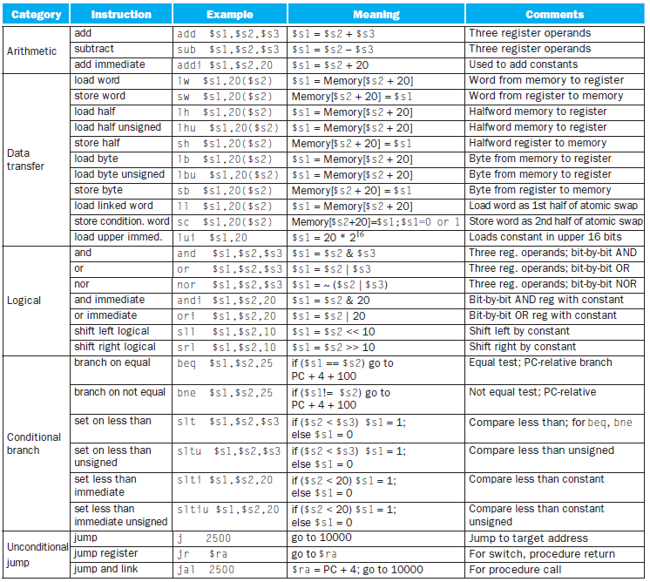
MIPS Instructions

Slide 55
Office Hours
Monday 1120-1210 @ My office

